Slide 1
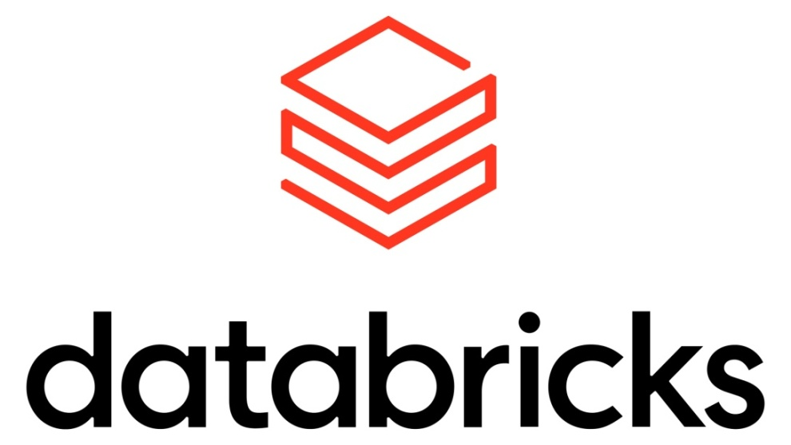
Azure DevOps
Implement CI/CD workflows in Azure Databricks

Slide 2
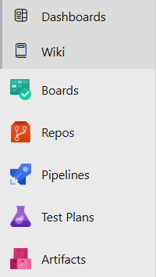
Agenda : Azure DevOps:
How to create Organization in DevOps?
How to create Pipeline?
How to integrate Databricks with DevOps?
How to change different stages for our deployment?
Practical:
Commit, share, and sync your code
Clone a repository
Import a Git repo into your project
Update code with fetch and pull
Undo changes in your Git repo

Slide 3
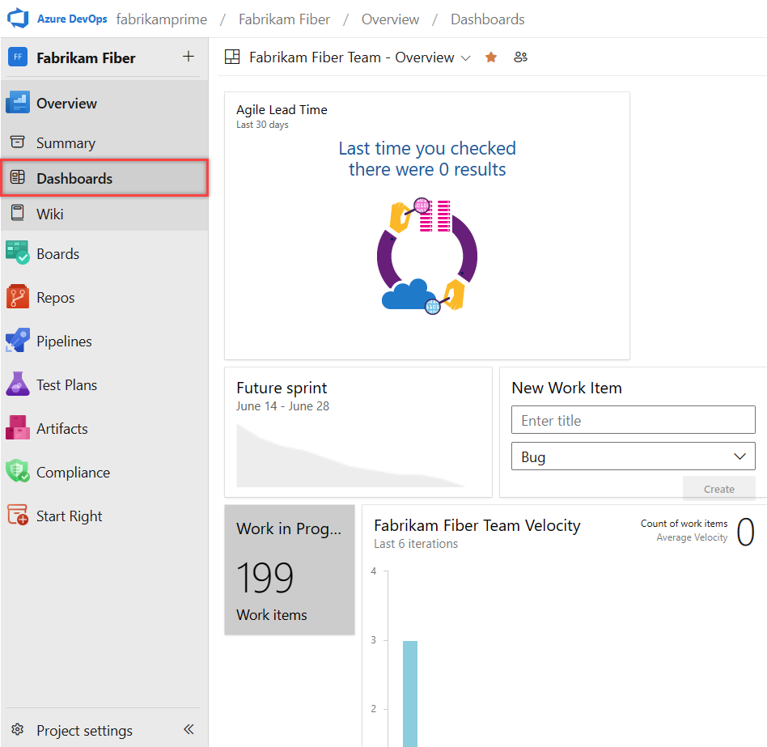
Key characteristics:
Azure DevOps:
Azure DevOps: Azure DevOps is a cloud-based platform that provides integrated tools for software development teams.
It includes everything you need to plan work, collaborate on code, build applications, test functionality, and deploy to production.
End-to-end project management
Client/server model delivery
Flexible and scalable service options

Slide 4
How Azure DevOps services work together
Typical workflow:
Plan work items in Azure Boards
Code features in Azure Repos with pull requests
Build and package with Azure Pipelines and Azure Artifacts
Test manually and automatically using Azure Test Plans
Deploy through Azure Pipelines to various environments
Monitor progress and metrics via Dashboards
Iterate based on feedback and new requirements

Slide 5
Azure Pipelines
Core capabilities:
Automated builds: Trigger builds on code commits with automatic integration and verification
Test integration: Run tests after builds to validate changes and detect issues early
Release pipelines: Deploy builds across environments from staging to production
Key features:
Continuous integration (CI): Automatically build and test code changes
Continuous delivery (CD): Streamline reliable releases from development to production
Build automation: Customize build processes with defined steps and triggers
Release management: Configure multi-environment deployment pipelines
Deployment automation: Reduce manual effort and deployment errors
Approval workflows: Add verification layers before promoting builds
Release tracking: Monitor deployments across environments

Slide 6
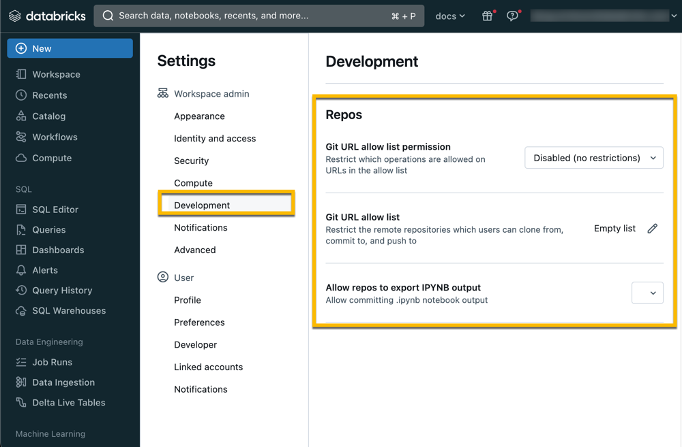
What is Databricks Git folders
Databricks Git folders is a visual Git client and API in Azure Databricks. It integrates Git repositories within your Azure Databricks workspace and supports common Git operations such as cloning a repository, committing and pushing, pulling, branch management, and visual comparison of diffs when committing.

Slide 7
What is CI/CD?
CI is the abbreviation for Continuous integration. This is the principle that developers merge their feature changes (via feature branches) into a master or development branch multiple times a day. The next step in the CI process is to compile the code on a build server with each merge.
Developers create and run unit tests for their changes locally. After that, the developer pushes the changes into the remote repository and creates a pull request. After completion, the CI build pipelines starts a build, runs automated tests, both unit and integration tests, and deliver statistics on the test process. The end result for Business Central projects is an .app file. This is called an artifact.
The CD part in CI/CD of the acronym is continuous delivery or continuous deployment. Continuous deployment even takes it a bit further, where you set up an automated deployment process. After some pre-requirements are met, the release pipeline automatically deploys the latest version, without manual interaction. CI/CD is fully supported with Azure Pipelines and can be applied and used with Business Central.

Slide 8
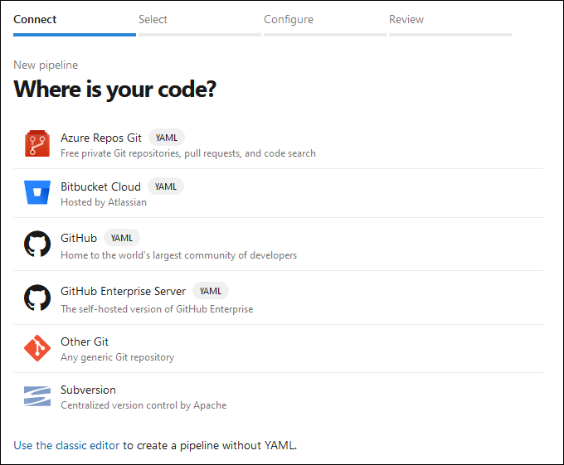
Create a build pipeline
A pipeline is a series of sequential steps that you need to configure. Azure Pipelines support the usage of YAML (Yet Another Markup Language) files. These text-based files can be part of your code in Azure Repos.

Slide 9
Automate CI/CD pipelines
Automating CI/CD pipelines further enhances the development workflow by integrating Databricks with continuous integration and delivery tools such as Azure DevOps, Jenkins, or GitHub Actions. These pipelines can automate testing, validation, and deployment of notebooks and workflows.
For example, a pipeline defined in Azure DevOps can trigger notebook execution and validation on every commit to the repository, ensuring that code changes meet quality standards before being deployed to production clusters. When you automate tasks in such pipelines, you streamline the deployment process and minimize manual intervention.
Monitoring and maintaining version control is an ongoing process that involves regular reviews, merging branches, and tagging releases. Teams should periodically review and merge feature branches into the main branch to keep it stable and up-to-date.

Slide 10
Perform unit testing
Unit testing focuses on validating individual components or functions of the codebase in isolation, ensuring that each part performs as expected.
Unit testing in Azure Databricks is an important practice for ensuring that individual components of your data processing pipelines are working as expected. In Azure Databricks, you can use libraries such as pytest and unittest for writing unit tests.

Slide 11
Perform integration testing
Integration testing, on the other hand, verifies the interactions between different modules and services, ensuring they work together seamlessly.
Integration testing in Azure Databricks involves testing how different parts of your data pipeline work together. Integration testing ensures that the interactions between different modules, databases, and services are functioning correctly.
For example, you might want to test the end-to-end process of data ingestion, transformation, and storage. Databricks notebooks make it easy to simulate these workflows and validate the results.

Slide 12
Implement rollback and roll-forward strategies
Rollback and roll-forward strategies help in managing and recovering from failures or errors in data processing workflows:
Rollback involves reverting to a previous state of the data.
Roll-forward applies pending changes to move forward after an issue is resolved.
By scripting the logic for detecting failures, triggering rollbacks, and executing roll-forwards, you can create resilient ETL workflows. You can set up alerts and monitoring to quickly spot and fix issues, reducing downtime and keeping your data safe.
Managing notebooks with Git commands within Databricks is essential for effective version control. You can perform standard Git operations like commit, push, pull, and merge directly from Databricks notebooks.

Slide 13
Implement Continuous Integration (CI) with Azure DevOps
Integrating Databricks tests into an Azure DevOps pipeline ensures that your code is continuously tested as part of your development workflow. You can define a pipeline in Azure DevOps that includes steps for testing your Databricks notebooks.
Collecting and preparing domain-specific datasets is a key step in fine-tuning a large language model using Azure OpenAI within Azure Databricks
Question: What role does the 'learning rate' parameter play during the fine-tuning process in Azure Databricks?
Answer: It controls the step size for weight updates during training

Slide 14
Common Facts
Agent Pools are used to group different build agents. An agent pool is targeting either cloud builds or on-premises builds.
A YAML (or Yet Another Markup Language) file is used to describe all the steps in a build definition. A pipeline can be based on this YAML file.

Slide 15
Check your Knowledge:
What is the primary purpose of implementing version control in Azure Databricks?
To manage code changes, collaborate with team members, and maintain the integrity of data pipelines and machine learning models.
What is the purpose of unit testing in Azure Databricks?
To validate individual components or functions of the codebase in isolation.
What is the role of init scripts in configuration management in Azure Databricks?
Init scripts are used for installing necessary libraries, configuring system settings, or setting environment variables.

Slide 16
References:
https://learn.microsoft.com/en-us/training/modules/use-azure-pipelines/1-introduction
https://learn.microsoft.com/en-us/azure/devops/get-started/?view=azure-devops
https://learn.microsoft.com/en-us/azure/databricks/repos/
https://www.youtube.com/watch?v=k9Kuz19ByNg
https://learn.microsoft.com/en-us/azure/devops/repos/?view=azure-devops
https://learn.microsoft.com/en-us/azure/databricks/repos/ci-cd
https://learn.microsoft.com/en-us/training/modules/ci-cd-workflows-pipelines-azure-databricks/01-introduction
https://aws.amazon.com/devops/continuous-integration/

